Slide 1

Factors That Affect Rent Prices in Chicago
Group Members: Joseph Wantroba, Amy Cleveland, Garima Chauhan, Gabriela Hernandez , Kelly Lao
Notes:
Kelly

Slide 2
Table of Contents
Overview
Questions of Interest
Data Exploration
Discussion on Implications
Post Mortem
Hypothesis
Summary
Notes:
Kelly

Slide 3

Overview
Factors that can affect rental prices in Chicago
Nightlife
Restaurants
Groceries
Education
Crime
Airbnb
Income
Walkability Score
Notes:
Kelly
As a group, we brainstormed and thought of these factors that might affect rent price

Slide 4
Questions of Interest
Is there a correlation between the median rent price and household income level?
Does having more amenities increase the rent prices in the area?
Do short term rentals such as Airbnb have an effect on long term rent prices?
Do higher crime rates and higher poverty rate correlate to lower rent prices?
Do the median rent and median home value by zip code follow the same trend?
Do higher school ratings in a neighborhood result in higher rent prices?
Do higher walkability scores result in higher rental prices?
Notes:
Kelly
Brainstorming questions – change the order to match slide
Pick 2-3 Qs

Slide 5

Hypothesis
Zip codes with more amenities, higher income, lower crime rates, lower poverty rates, and higher average number of Airbnb reviews tend to have a higher median rent prices.
Notes:
Kelly

Slide 6


Data Research
Zillow data from: Quandl
Yelp
City of Chicago
US Census
Airbnb from: Insideairbnb.com
Notes:
Gaby

Slide 7


No Access!
GreatSchool API
Walkability Score
Notes:
Gaby

Slide 8
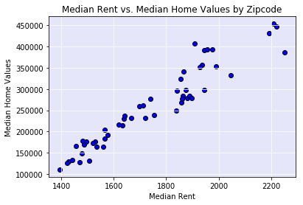
Median Rent Price vs Median Home Value
Correlation Coefficient = 0.95
Notes:
Gaby
Highly correlated so we chose to use rent as our dependent variable because we have more data points than home values

Slide 9
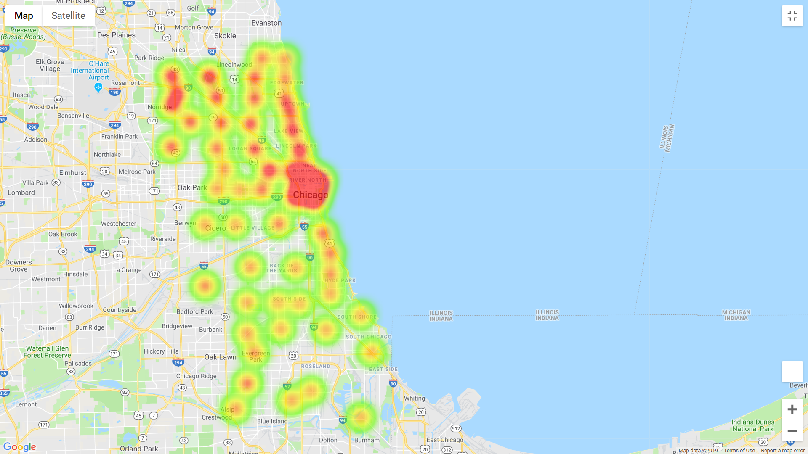
Chicago Rent Price Heat Map
Notes:
Gaby
this will be our dependent variable, so we are showing this

Slide 10
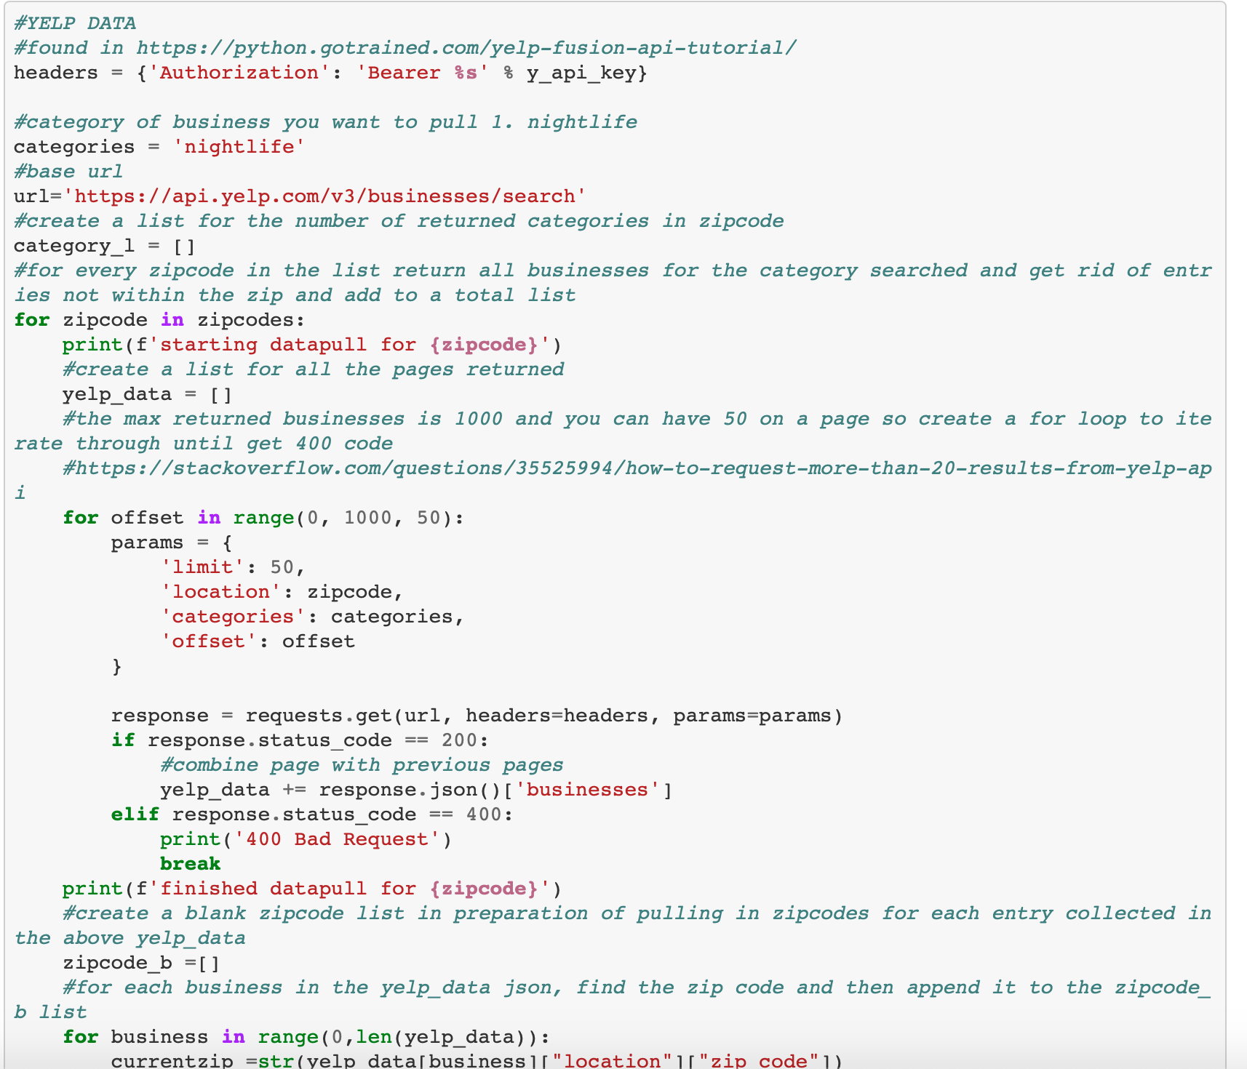
Amenities Codes
Data Exploration and Cleanup.ipynb
Notes:
Joe
https://github.com/GarimaChauhan16/DataScience_Project1/blob/master/Data_Exploration_and_Cleanup.ipynb
Pull the yelp data API

Slide 11
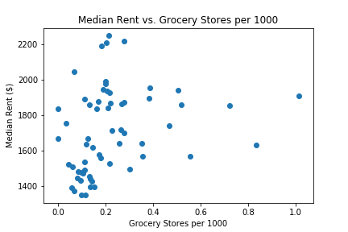
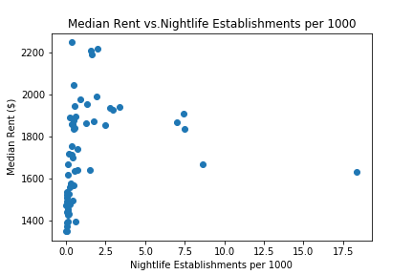
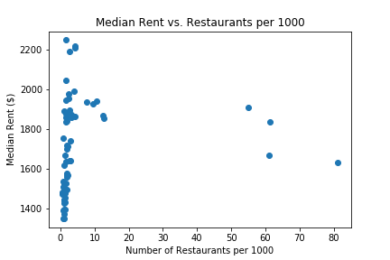
Rent vs. Amenities by Zip Code (per 1000)
Grocery
Nightlife
Restaurant
Correlation Coefficient = 0.26
Correlation Coefficient = 0.20
Correlation Coefficient = 0.11
Notes:
Amy

Slide 12
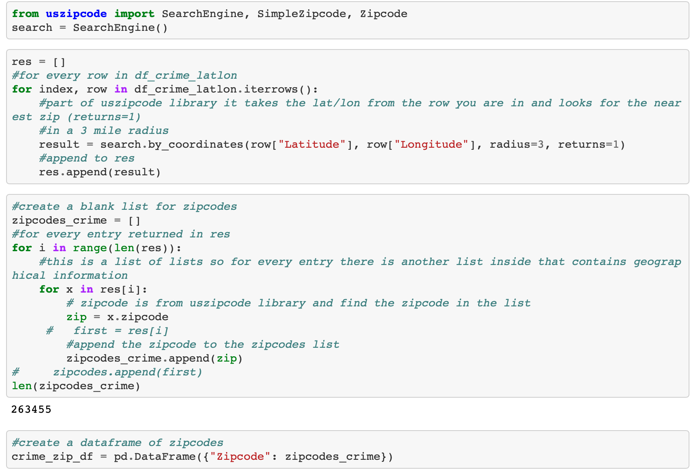
Latitude & Longitude into Zip code Codes
Data Exploration and Cleanup.ipynb
Notes:
Garima
https://github.com/GarimaChauhan16/DataScience_Project1/blob/master/Data_Exploration_and_Cleanup.ipynb

Slide 13
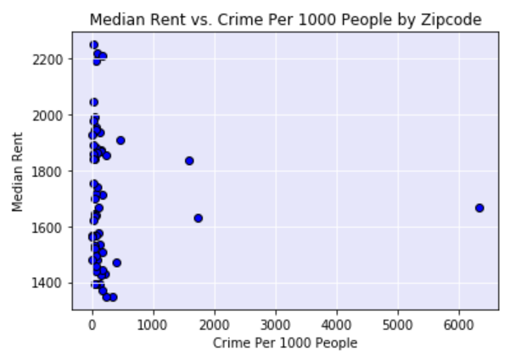
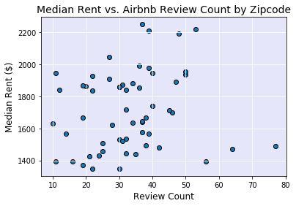
Rent Vs. Crime Rate & Airbnb Reviews by Zip Code
Correlation Coefficient = - 0.04
Correlation Coefficient = 0.14
Notes:
Amy

Slide 14
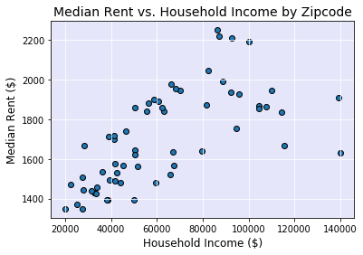
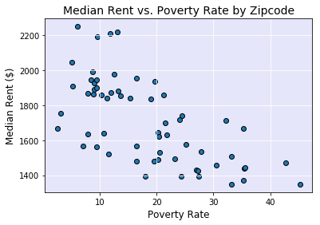
Rent vs. Household Income and Poverty Rate by Zip Code
Correlation Coefficient = 0.66
Correlation Coefficient = -0.56
Notes:
Gaby

Slide 15
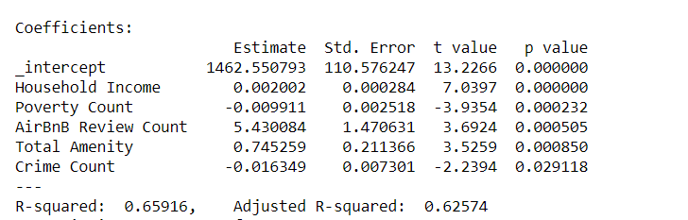
Regression Analysis
Notes:
Joe

Slide 16
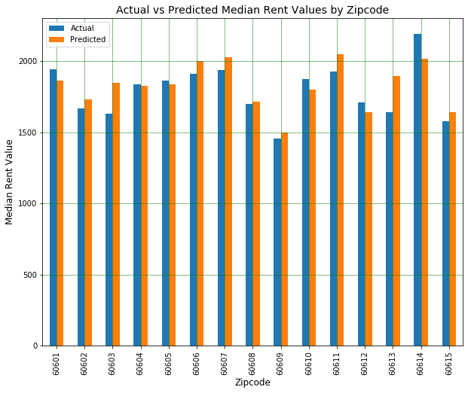
Actual vs Predicted Rent Prices by Zip Code
Median Household Income
Poverty Rate
Total Crime Count
Average Airbnb Reviews
Total Amenities (Grocery, Nightlife, Restaurants)
R²= 0.66
Notes:
Garima
In order to verify how well the above variables predicted rent prices in Chicago, we ran a multi-linear regression. We ran a multiple iteration of the regression model, the final model included the follow variables, and those are: …

Slide 17
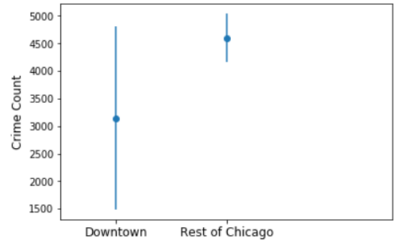
T-Test on Crime Counts
P Value = 0.45
NOT Statistically significant
Notes:
Joe

Slide 18

Discussion on Implications
Chicagoan do care about amenities and crime rate when looking for housing but median rent price is also driven by other factors. More tests needed to be done to identify them.
Notes:
Amy

Slide 19

Summary
In summary, we didn’t always find a high correlation with each variable independently , but when these variables are combined in a multi-linear regression model, we are able to account for 66% of the variance in median rent price.
Notes:
Amy
Summary
For this project we reviewed whether certain neighborhood characteristics effect the rent prices for a given zip code in Chicago. The number of amenities and crime per 1000 people and average Airbnb reviews were not strongly correlated with median rent price. However, there is an inverse correlation of median rent price with the poverty rate and total crime count. There is also a positive correlation of median rent price with total amenities and median household income. When these variables are combined in a multi-linear regression model, we are able to account for 66% of the variance in median rent price.

Slide 20
Post Mortem
Successful
Used code to convert latitude and longitude into zip code for accurate comparison
Yelp – Found a way to iterate through all reviews as Yelp initially only returns 50 at a time
Notes:
Gaby

Slide 21
Post Mortem
Unsuccessful
Merge Conflicts with the checkpoint folder
Access to Data
Education
Walkability Score
Notes:
Gaby

Slide 22
Post Mortem
Lesson Learned
Although home values and rent prices were aligned, we may have to analyze how these variables relate to home values separately.
It may also be helpful to perform a time series analysis to capture how these variables change over time.
Zip code may be too large of a geographical area to assess indicators of rents; it may be better to look at census blocks or community area.
There might be better variables to measure amenities. We only included quantity measures not quality such as number of reviews, ratings, etc.
Our scope was based on easily accessible data. If given more time, we would have tested public transportation access, school ratings, walkability scores, and supply type variables such as building permits, number of available units, etc.
Notes:
Amy

Slide 23


Thank you!

Slide 24
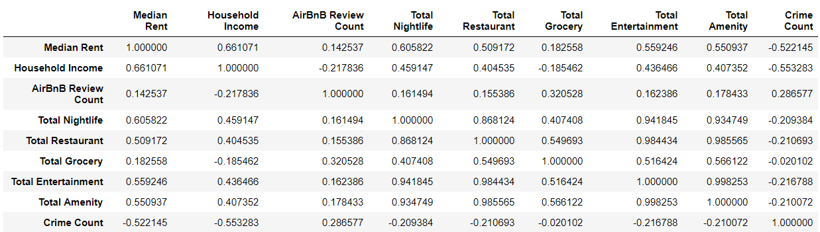
Appendix – Correlation Table

